Slide 1
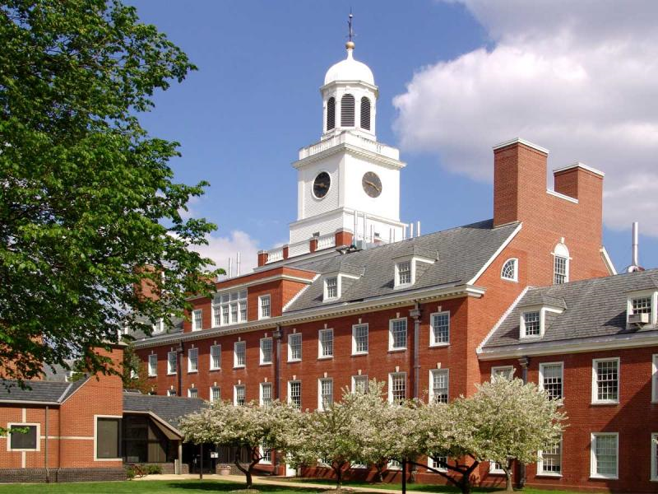
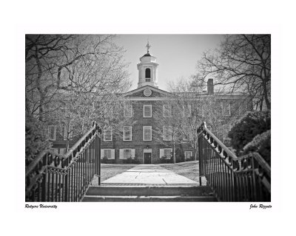

Evolutionary origin of correlated mutations in protein sequence alignments
Alexandre V. Morozov
Department of Physics & Astronomy and
BioMaPS Institute for Quantitative Biology,
Rutgers University
morozov@physics.rutgers.edu
ASBMB Tahoe, October 2009

Slide 2
Outline
Molecular phylogeny and evolutionary theory
Patterns of correlations in protein sequence alignments: HIV-1 protease
Biophysical models of protein evolution

Slide 3
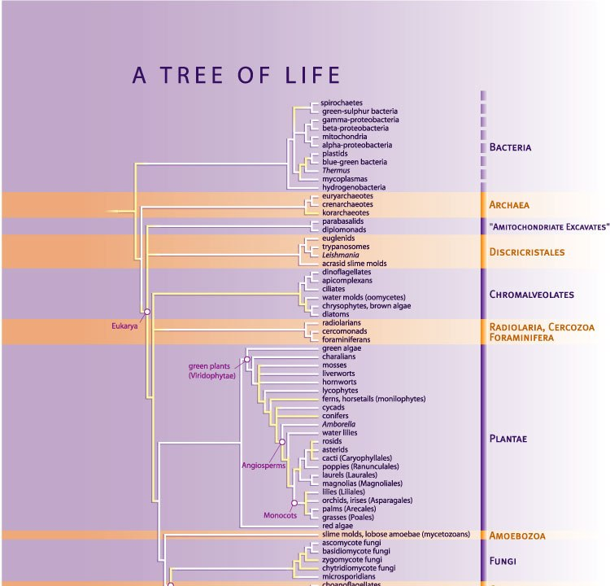
Science's Tree of Life Special Issue (2003)

Slide 4
Molecular phylogeny: inference of divergence times
x5 (root)
t4
x4
t2
t3
t1
x1
x2
x3
Find {t} by maximizing P({x}|T,{t}), where {x} are the observed sequences
at leaf nodes, and {t} are tree edge lengths:
P(x2|x1,t) – probability of sequence x1 to evolve into x2 in time t.

Slide 5
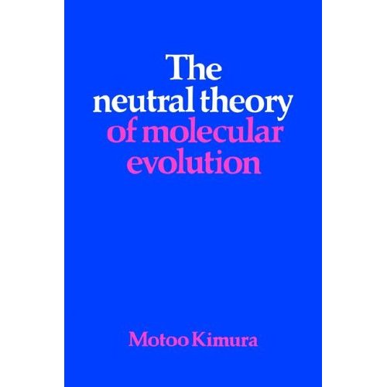
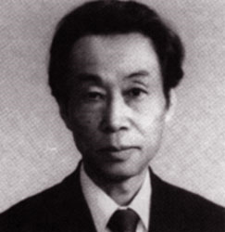
Assumptions of molecular phylogeny
site independence
neutrality
Efficient ML method for finding P({x}|T,{t}) – recursion on a tree (Felsenstein 1981)
Probabilistic models of phylogeny are based on neutral theory:
neutral mutations (not just selection!) are a major evolutionary force

Slide 6
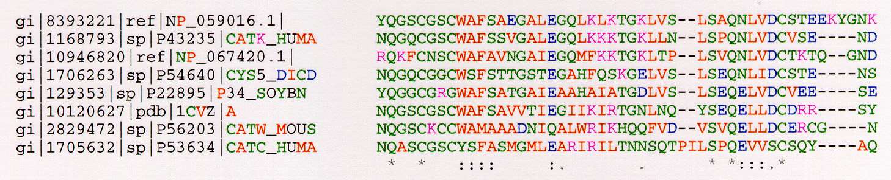
Correlations in protein sequence alignments
I
K
J
Sequence alignment for a region of a thiol protease family (active site contains CYS). Residues that are completely conserved are indicated by *, essentially conserved by either : or . Several types of structural/functional characteristics are indicated by color coding: red indicates hydrophobic characteristics, green hydrophilic characteristics, purple is positive charge, and blue negative charge.

Slide 7
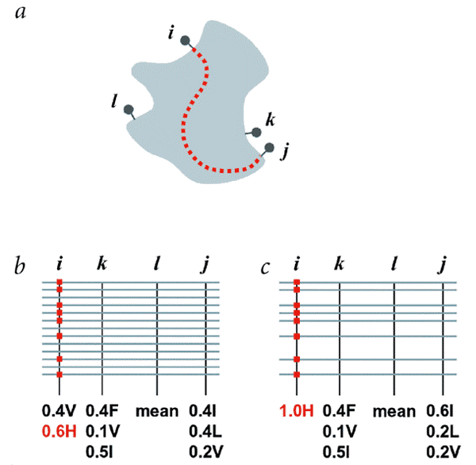
Statistical coupling analysis
Suel et al, NSB 2003

Slide 8
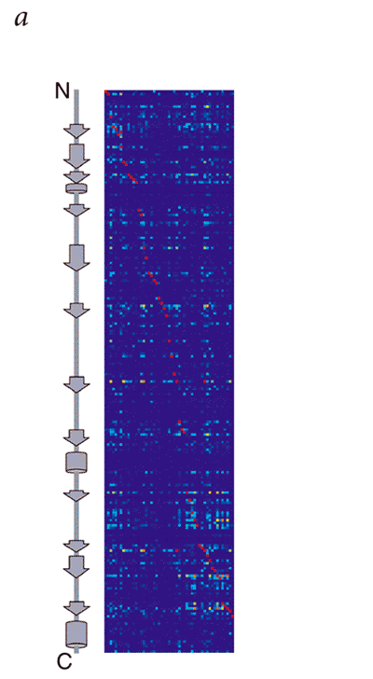
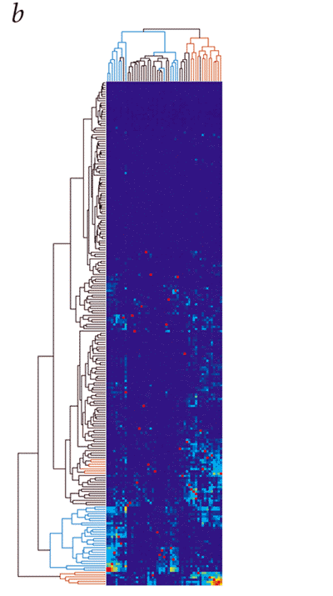
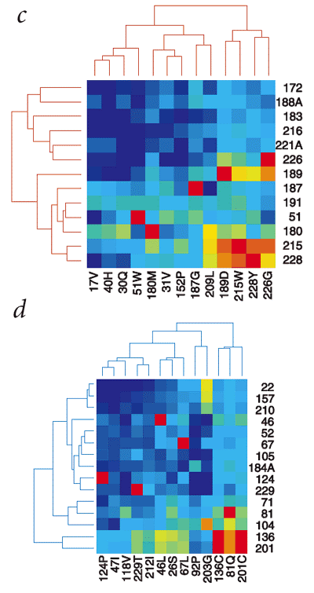
Statistical coupling analysis of the chymotrypsin-family of serine protease
Suel et al, NSB 2003

Slide 9
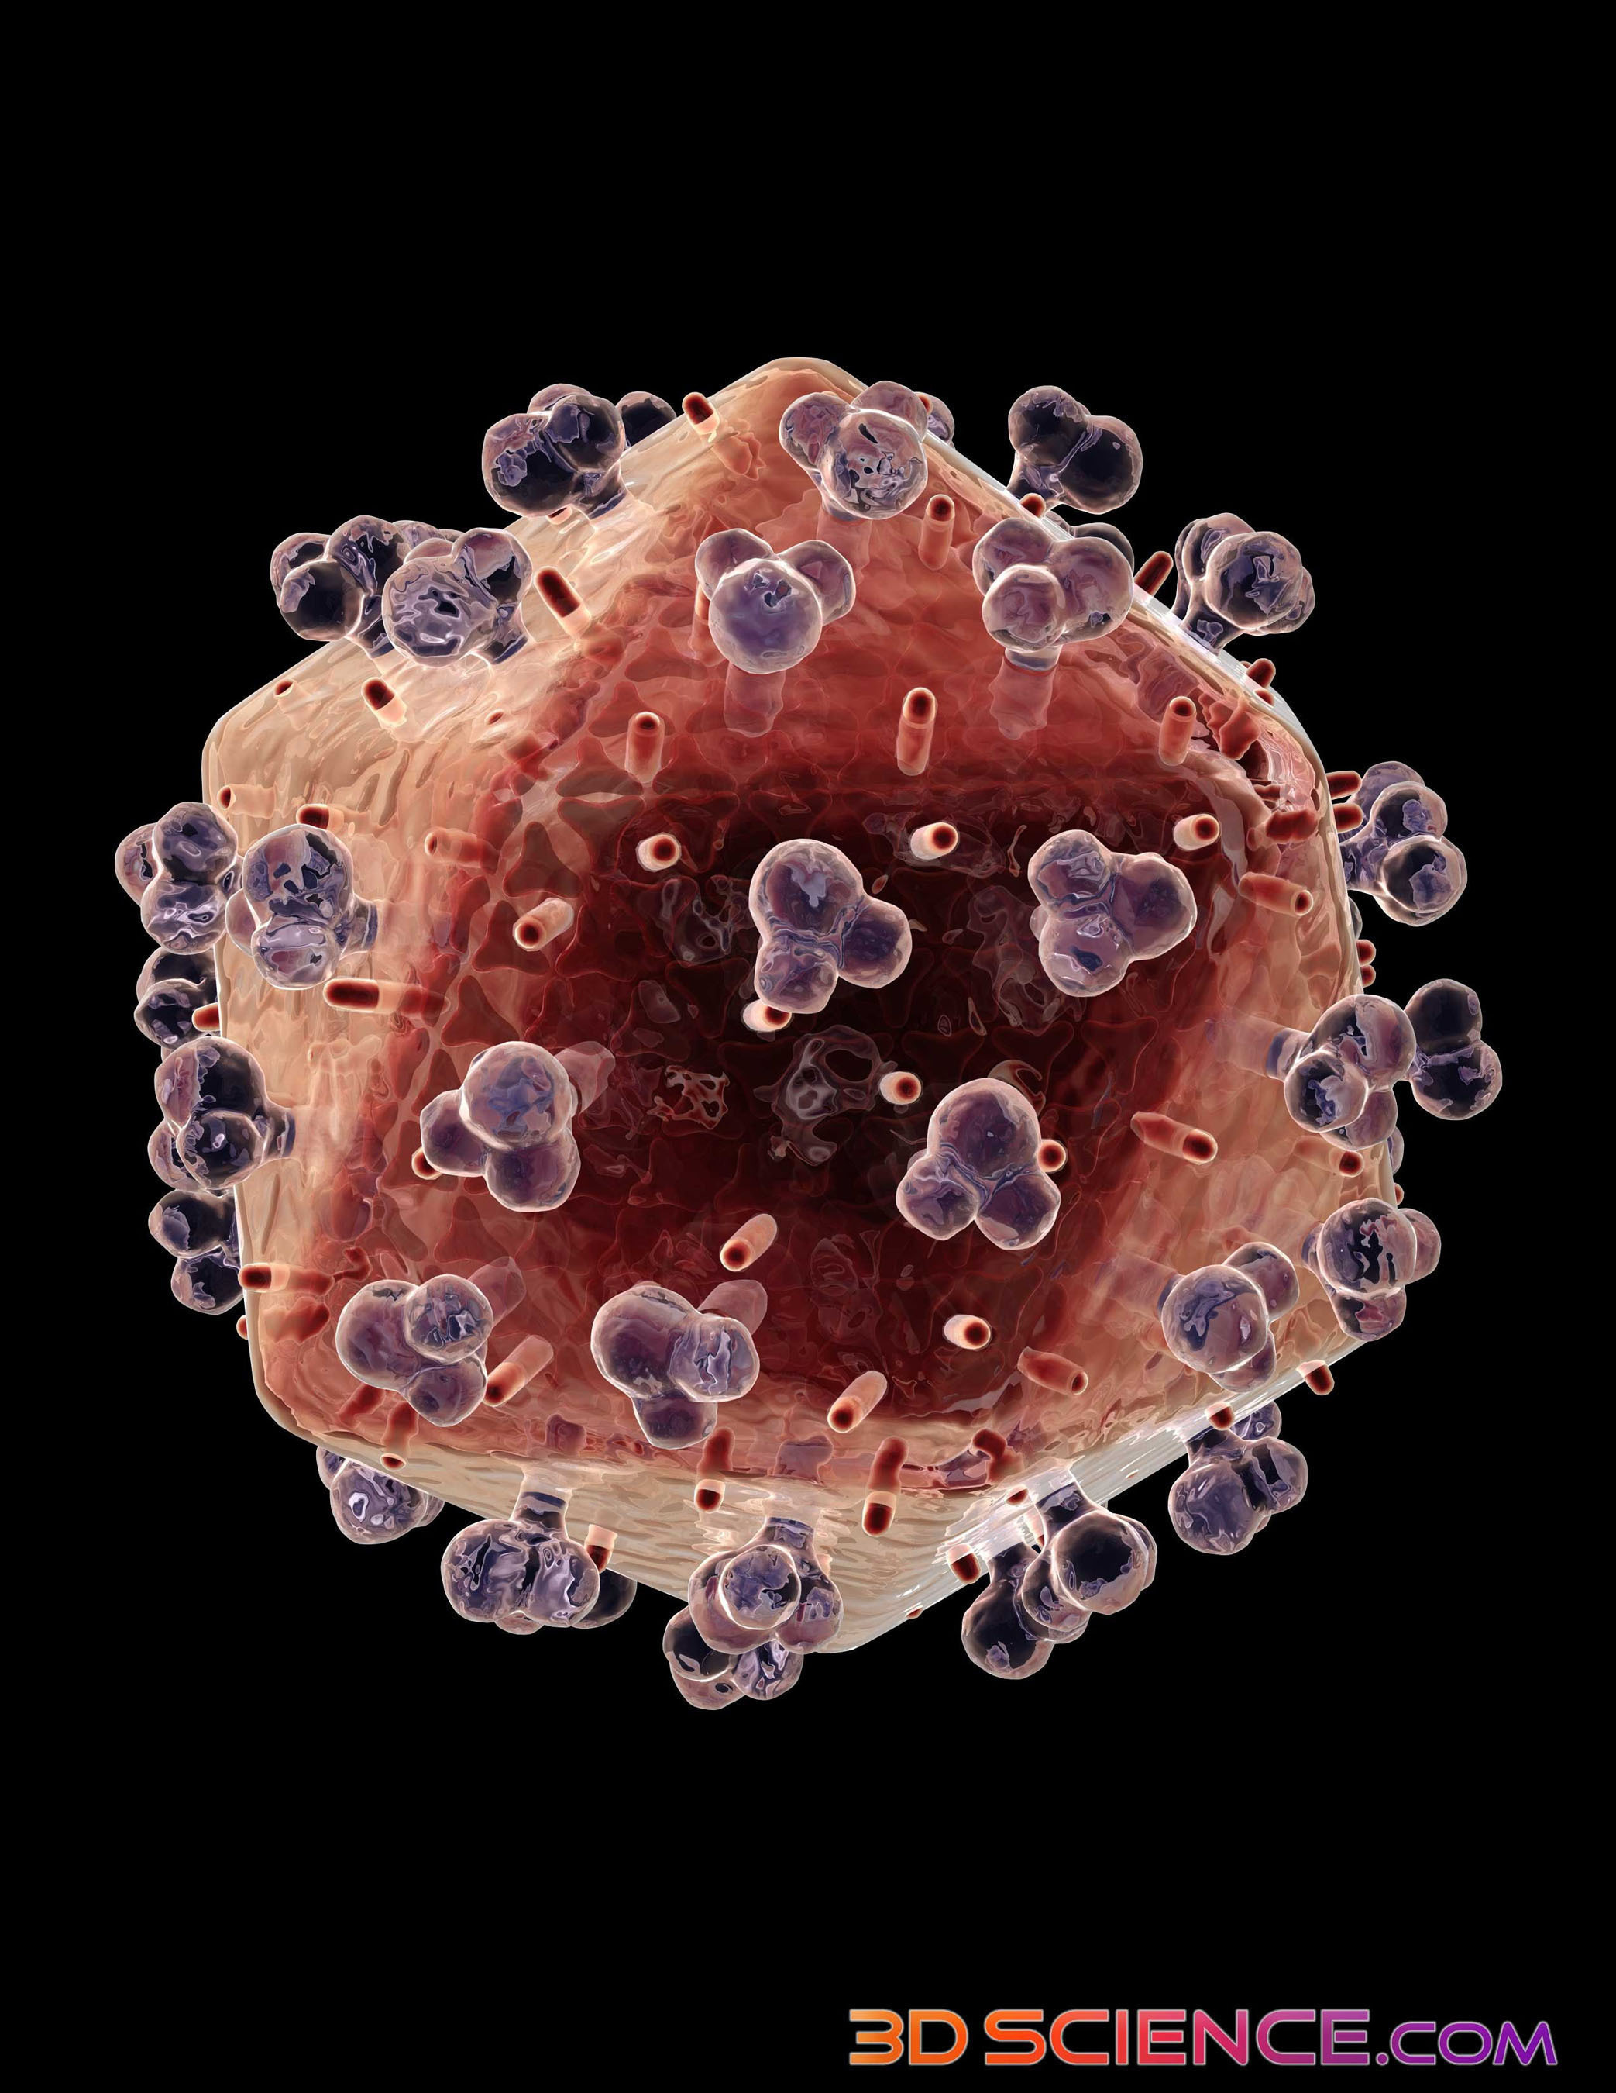
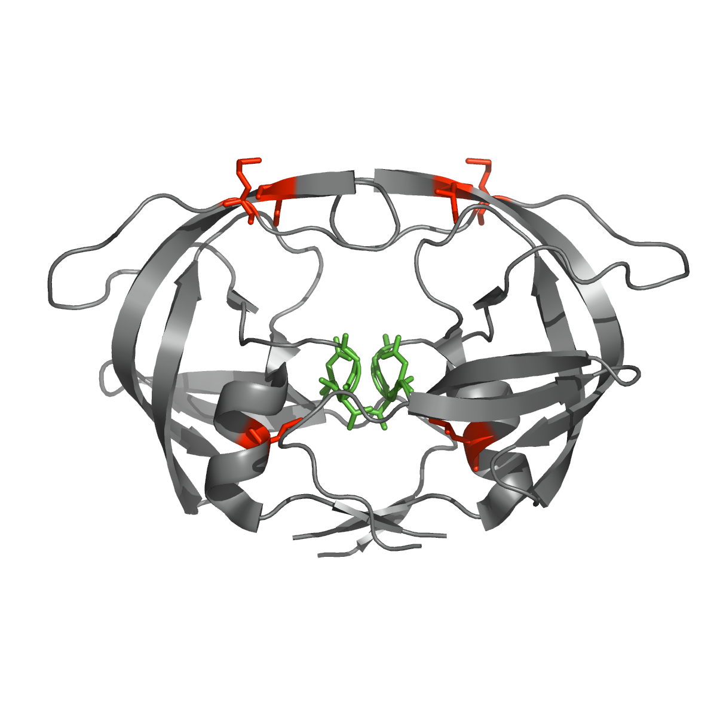
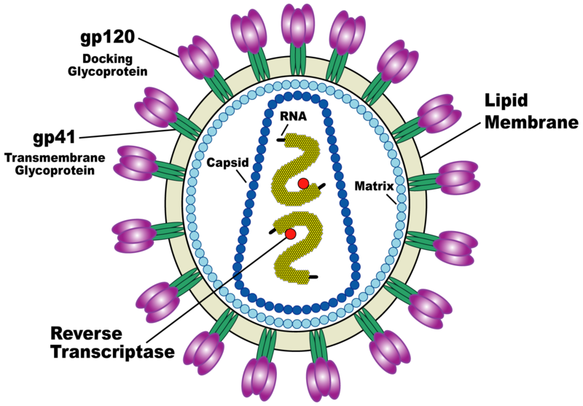
Adaptive evolution and fitness of HIV-1 protease
Structure of the HIV protease dimer (PDB code 1HN0). The catalytic triad is shown in green.
Coded for by the pol gene of HIV-1
Cleaves GAG (group-specific antigen) precursor proteins at a specific site
Key target of HIV treatments
99 amino acids long, O(10^4) sequences available
Haq et al, BMC Bioinform 2009

Slide 10
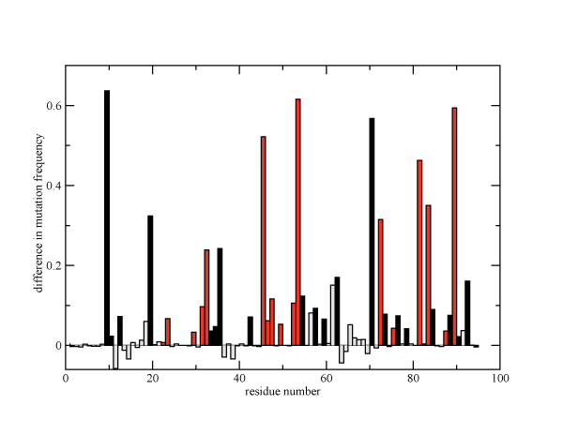
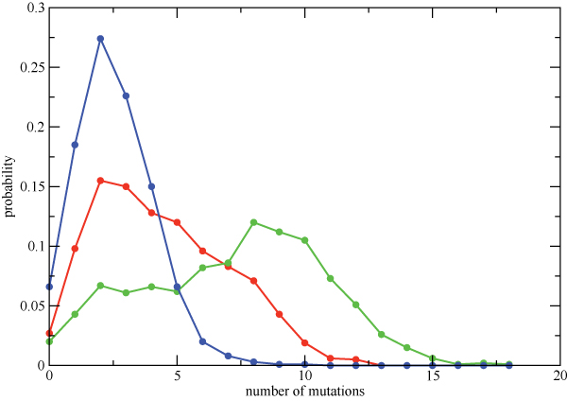
Mutational patterns in HIV protease
Difference between PI5+ and PI0
Primary drug resistance positions (red),
Accessory drug resistance positions (black),
Unrelated positions (grey)
PI0 (blue), PI1 (red), PI2+ (green)
PI – protease inhibitor
Haq et al, BMC Bioinform 2009

Slide 11
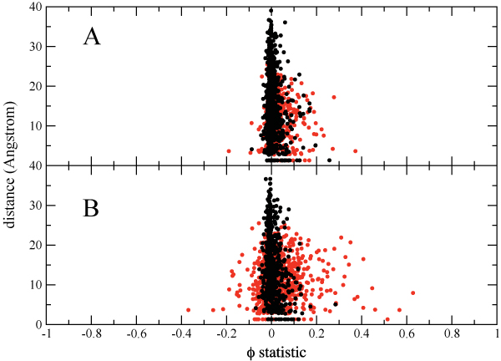
Pair correlations vs. distance
PI0 cohort
PI2+ cohort
φ statistic
non-drug associated positions
drug associated positions
20 aa {A,G, ..,Y} alphabet -> {0,1} alphabet
Haq et al, BMC Bioinform 2009

Slide 12
A hierarchical formalism to study interactions between residues
We use an information-theoretic method to estimate the magnitude of pair, three-body, and higher-order interactions by fitting log-linear models:
Here I,J,K are 0 for wild-type residues and 1 for mutations. Parameters λ are estimated by maximum likelihood, and the amount of N-body interaction is expressed in terms of an entropy difference between the full model and the maximum entropy model with higher-order terms set to 0.

Slide 13
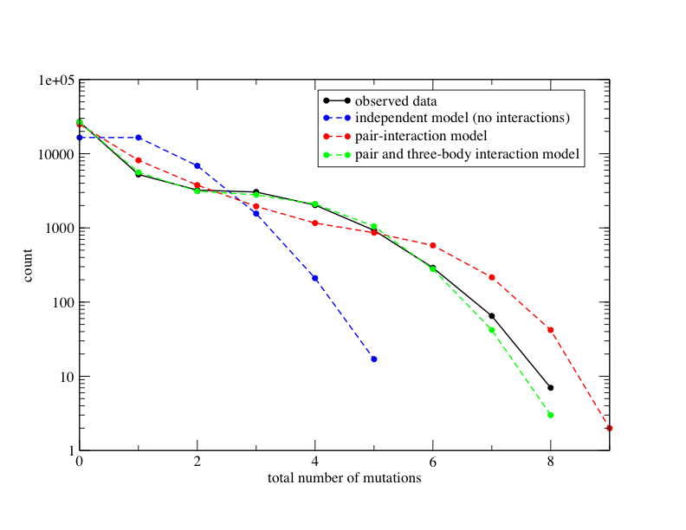
Role of higher-order correlations in predicting the frequencies of multiple mutations
Observed and predicted mutational distributions for a ten-residue group (20-32-46-48-53-54-58-74-82-90) using models with varying degrees of interaction.

Slide 14
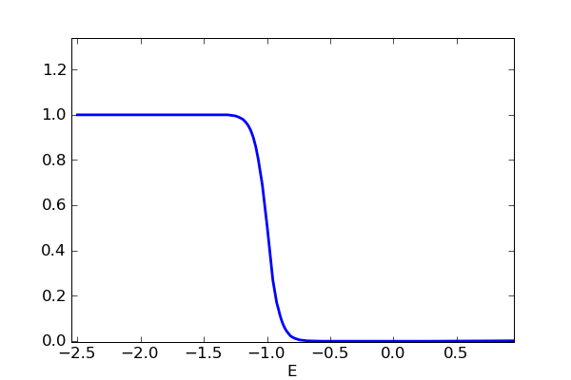
Contribution of protein stability to fitness: “evolution projected onto the energy axis”
TS
p_{f}
U
∆G
Protein folding landscape
F
Probability of a protein to be folded p_{f} is a function of its amino acid sequence S:
Hypothesis: Fitness(S(∆G)) is determined by p_{f} (S(∆G))

Slide 15
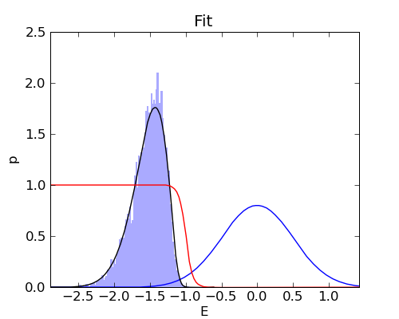
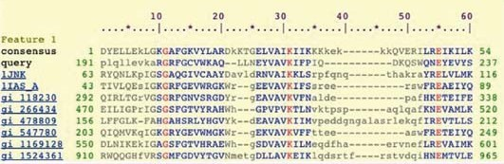
Inference of protein energetics in the presence of mutations
Evolved polymorphic protein population
Margin of stability, several kcal/mol
Selection on stability, with mutations (rate μ) and limited/no drift (large N):

Slide 16
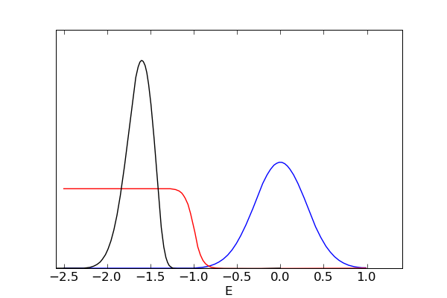
Mutations and non-linear fitness can explain observed correlations between amino acid sites
Evolved polymorphic protein population
Destabilizing mutation
x
Stabilizing compensatory mutation
Selection on stability, with mutations (rate μ) and limited/no drift (large N):

Slide 17

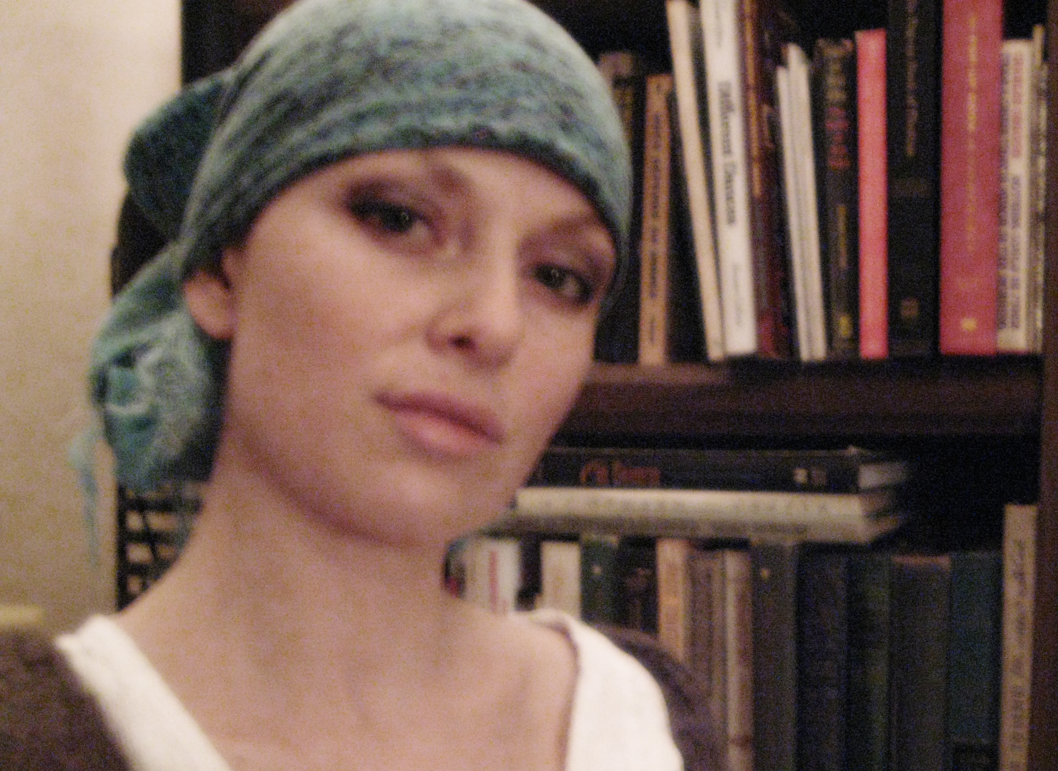


Lab Members and Funding
Lab members:
Dr. Denis Tolkunov
Allan Haldane
George Locke
Julia Tsitron
Funding:
NIH R01 HG004708
Alfred P. Sloan Fellowship
BioMaPS Institute for Quantitative Biology

Slide 18
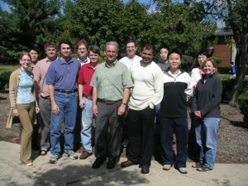

Collaborators
  Ron Levy, Mike Andrec, Omar Haq
  Anirvan Sengupta

Slide 19
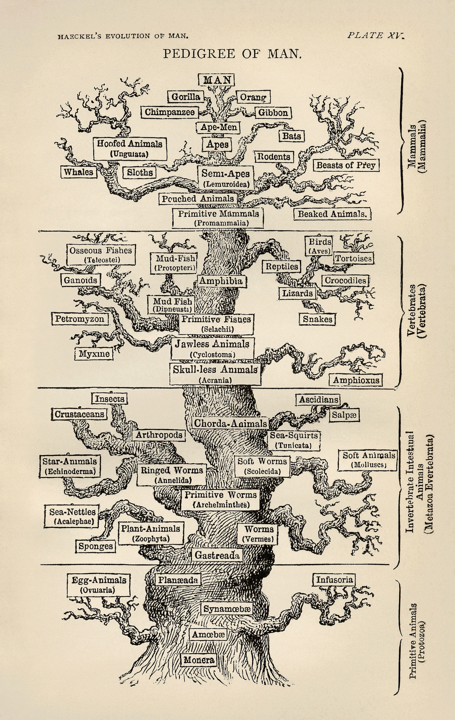
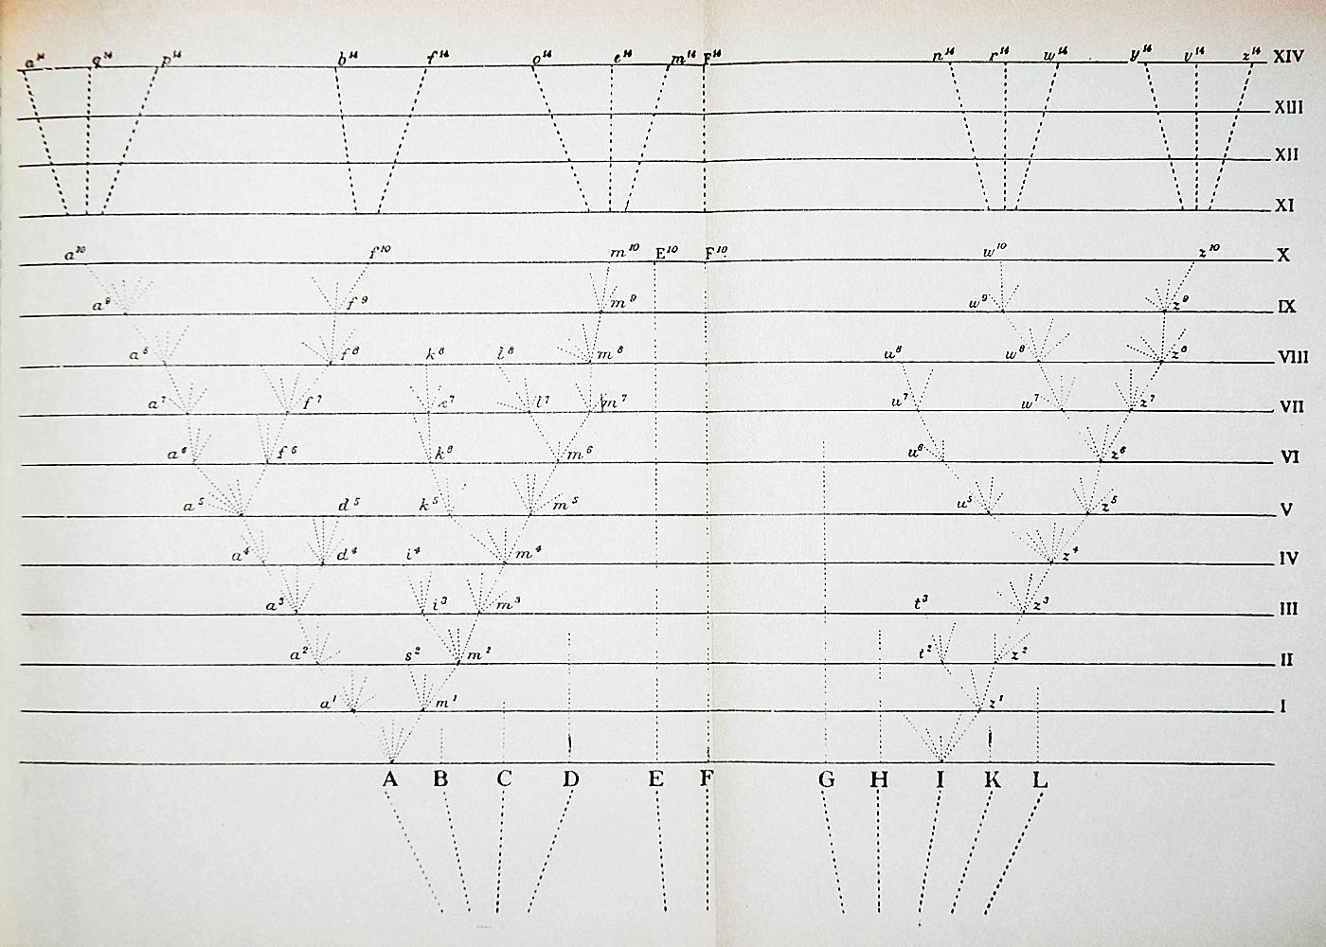
The Tree of Life
Charles Darwin
On the Origin of Species (1859)
Ernst Haeckel
The Evolution of Man (1879)

Slide 20
Evolutionary forces: mutation, selection, and drift
a
d
c
a
b
a
d
a
a
c
a
a
…
fixation
N=4 alleles
1/4 probability to fix any of the 4 alleles
More generally, where p is the allele frequency.
With mutations, average rate of substitution ρ is given by

Slide 21
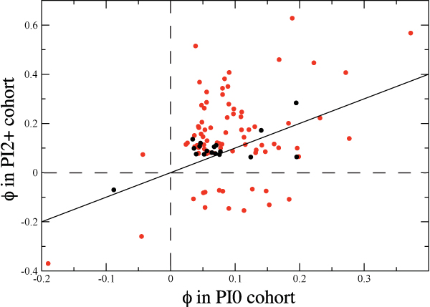
Drug treatments induce changes in the pattern of pair correlations
non-drug associated positions
drug associated positions

Slide 22
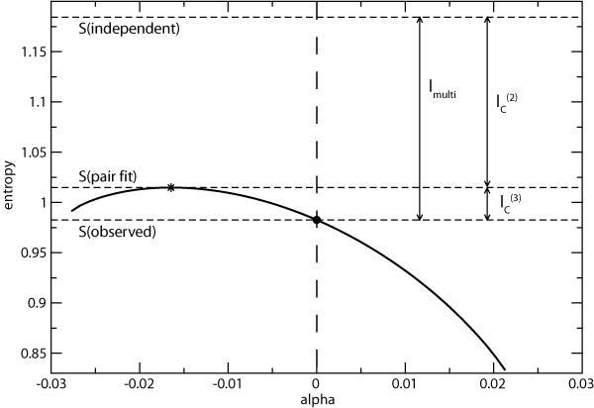
Entropy measures
Entropy of family of triplet distributions for the 46-54-90 triplet (PI2+ cohort)
Shannon entropy

Slide 23
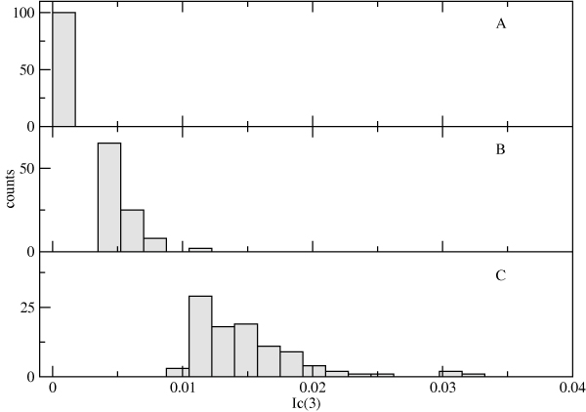
Importance of higher-order correlations
Distribution of the 100 largest values for PI0, PI1, PI2+ cohorts

Slide 24

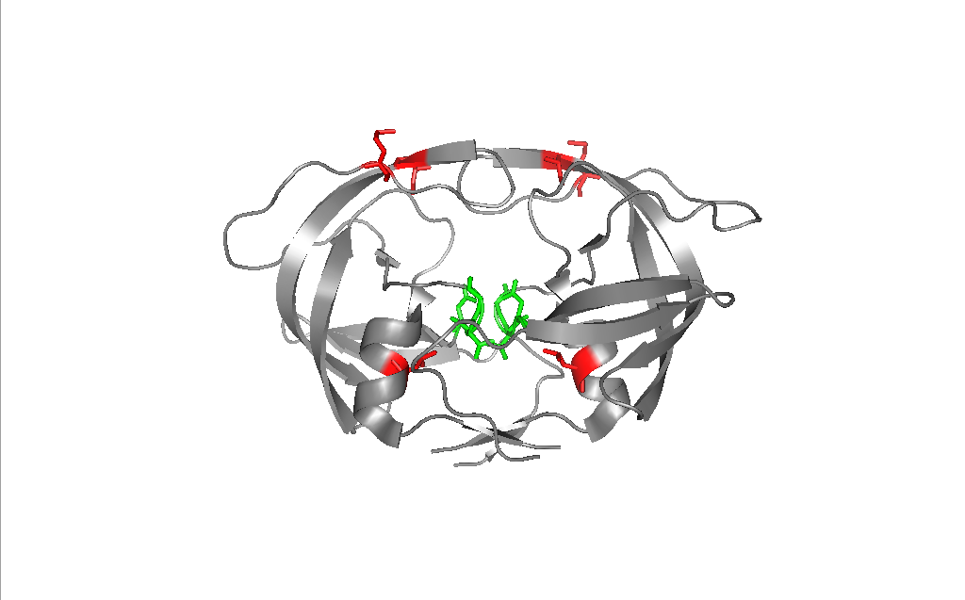
Insights from the HIV protease study
Protein evolution is driven by the need to:
  Maintain protein stability
  Maintain protein function (catalytic efficiency, optimal substrate binding, etc.)
  Evade drugs via resistance mutations (in the case of pathogens), or otherwise adapt to new environments
Protein function and stability are interdependent, as mutations which provide drug resistance may decrease protein stability, requiring compensatory “accessory” mutations to maintain fitness.
Such compensatory effects gives rise to correlations among mutations.

